Slide 1
BillionTests
Self diagnosis made easy
Vision - To make India healthier by enabling early, affordable, and accessible diagnostics for every citizen and every village.
AI Platform. Developed in India. Built for India

Slide 2
The Healthcare Crisis
BillionTests
Every year in India, preventable diseases claim hundreds of thousands of lives simply because screening happens too late—or not at all!
Condition | % of Indian Population | Annual Testing | Annual Deaths in India | Avoidable with Early Screening
Diabetes | ~8-8.3% adults | 20-25% | ~1,000,000 | 400,000-600,000
Chronic Kidney Disease | ~11-16% adults | <5% | ~175,000+ | 150,000-250,000
UTI | ~24% (adult women) | Variable | Not precisely recorded | 100,000-150,000
Liver Disease with bilirubinuria | NAFLD 9-32% (serious disease much lower) | <5% | ~268,000 | 10,000-30,000
TOTAL |  |  | >1.4 million | 670,000-1,080,000
DALYs (Disability-Adjusted Life Years) Lost: 10-20 million annual loss DALYs due to late detection of screenable diseases

Slide 3
Strip based analysis
BillionTests
Strip-based analysis is one of the simplest, fastest, and most cost-effective ways to get a preliminary diagnosis of critical health parameters—for ₹10 per test. Yet, despite its potential for scale, current approaches are riddled with challenges that prevent widespread adoption and reliable use, whether for humans, livestock, or pets.
Challenges with Current Approaches:
1: Manual Reading
Error-prone (depends on lighting, color perception, human judgment)
Slow (requires reading strips carefully at precise intervals)
Requires trained personnel (not scalable for home/field use)
Not scalable for mass screening programs
2: Imported Machines
Expensive (₹1-2 lakh per analyzer)
Dominated by foreign brands (Siemens, Roche, Abbott, Menarini)
Usually single-purpose (proprietary strip dependency)
Lab-bound (require electricity, stable environment)
3: Lab-Based Testing
Infrastructure-dependent
24-48 hour delays for results
Centralized data (no real-time health visibility)
High costs for patients
Impact:
Patients, farmers, and pet owners end up paying more, waiting longer, and health systems lose the chance for real-time, scalable diagnostics.

Slide 4
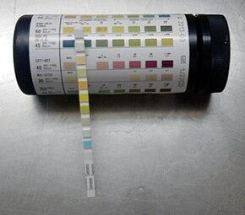
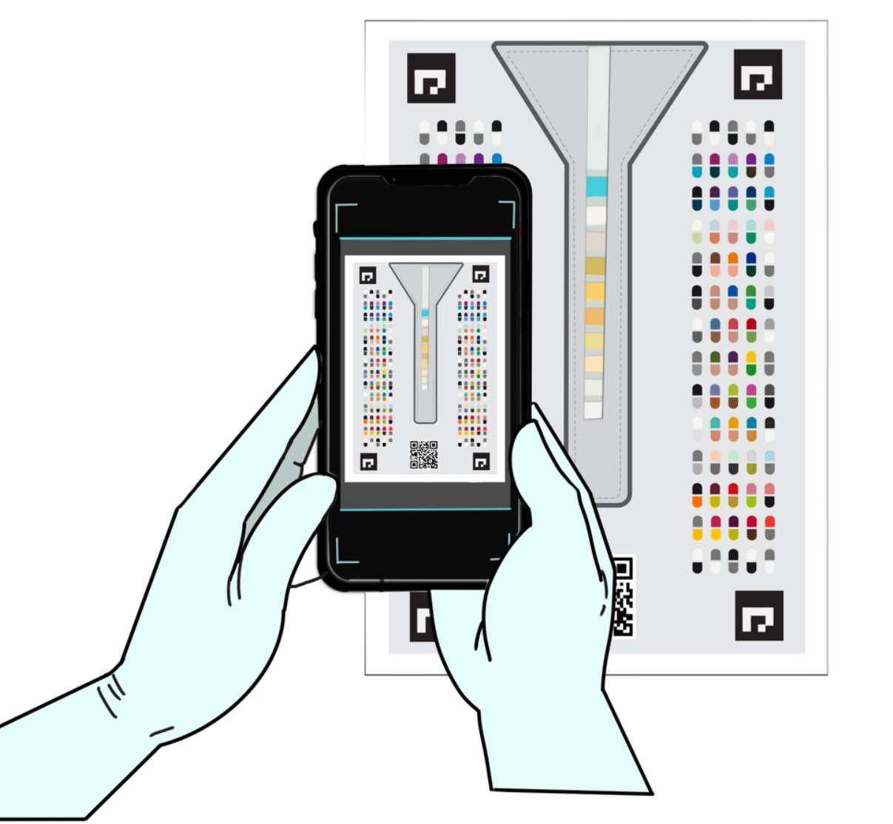

BillionTests: Introduction
BillionTests
BillionTests is India's first universal, AI-powered automated test-strip reading platform that combines:
Computer Vision AI + classical image processing – Trained on 100,000+ images for 98%+ accuracy
IoT Connectivity – Real-time data sync with health systems
Blockchain Security – Tamper-proof, verifiable test records
Transformation of strip based testing
Manual and error-prone
assessment
to
Automated and accurate Assessment

Slide 5
BillionTests: Introduction
BillionTests
Key Differentiators:
Works with 30+ types of diagnostic strips (human, cattle, pet)
98% accuracy through AI-powered image analysis
₹10 per scan (mobile app) or ₹1,999 portable device (vs ₹40k–₹2L imported analyzers)
Completely Made in India
Portable, offline-capable, electricity-free operation, field ready
Blockchain-secured, tamper-proof results for data trust
Compatible with all govt.- approved strips
The platform delivers lab-grade accuracy at field-level affordability, addressing critical gaps in India's preventive healthcare infrastructure.
Why Urine-Based Screening Is Powerful in India
  Low cost, non-invasive
  No lab dependency
  Results in 1–2 minutes
  Ideal for rural areas, elderly care, mass screening
No education needed – single click operation
5

Slide 6
Blockchain & Data Privacy
BillionTests
Tamper-Proof Results
Each test result is securely linked to time, device ID, and strip type, ensuring full traceability.
User-Centric Data Privacy
Patients retain ownership of their health data:
  Results are encrypted & stored privately.
  Sharing is consent-based → only doctors, labs, or insurers chosen by the user can access.
Immutable Blockchain Ledger
Test records are permanently stored on the blockchain, making them fraud-proof and verifiable for:
  Insurance claims (no fake reports)
  CSR/NGO programs (impact validation)
  Regulatory compliance (auditable history)

Slide 7
Innovation and novelty
BillionTests
1. Radically Affordable
₹1,999 device vs ₹1-2 lakh imports (99% cost reduction)
₹10 per scan vs ₹50-200 lab tests
Truly universal - works with ALL govt-approved strips—no vendor lock-in
Leverages mature supply chains instead of reinventing hardware
2. AI-Powered Accuracy
98% accuracy validated on 200+ samples
Trained on 100,000+ diverse images
Eliminates human reading errors and subjective interpretation
Continuous learning from real-world data
3. Zero-Friction Testing
Single-click smartphone app (Android/iOS)
BT Cards handle lighting/environmental variations automatically
No medical training required
Works anywhere—home, clinic, or remote village
Lean-by-design architecture – Uses existing strips, smartphones, and mature supply chains instead of reinventing hardware, enabling massive cost reduction and rapid scale.
The Bottom Line: Lab-grade diagnostics at 1% of the cost, accessible to anyone with a smartphone
7

Slide 8
Quick Health Clues from Urine Test Parameters
BillionTests
Parameter | Indicates Possible
Protein | Kidney disease, dehydration, intense exercise, kidney stones
Leukocytes (WBC) | Infection, UTI, kidney stones
Ketones | Low-carb diet, diabetes
Glucose | Diabetes (if >180 mg/dL)
Nitrites | Bacterial infection (E. coli, Gonorrhea)
Blood | UTI, intense exercise, kidney stones
Urobilinogen | Liver disease, cirrhosis, hepatitis, liver damage
pH (6.7–7.5) | Uric acid stones, excess protein intake
Specific Gravity | Dehydration, urine concentration issues
Bilirubin | Early liver disease, blocked bile duct

Slide 9
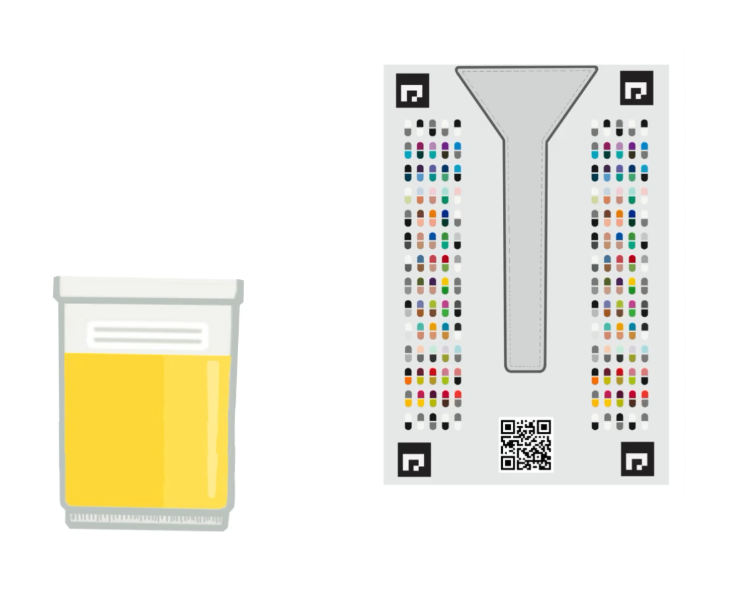
Solution 1 - Mobile App
BillionTests
Our cutting-edge AI technology simplifies the diagnostic process into three streamlined steps :
Scan
Use our intuitive mobile app to guide users in performing the test correctly.
2. Analyze:
Our sophisticated AI software instantly generates accurate test results within 20 seconds.
3. Action:
Get easy to interpret results and contacts of medical experts for further action via digital platform.
Click above to play the animation

Slide 10


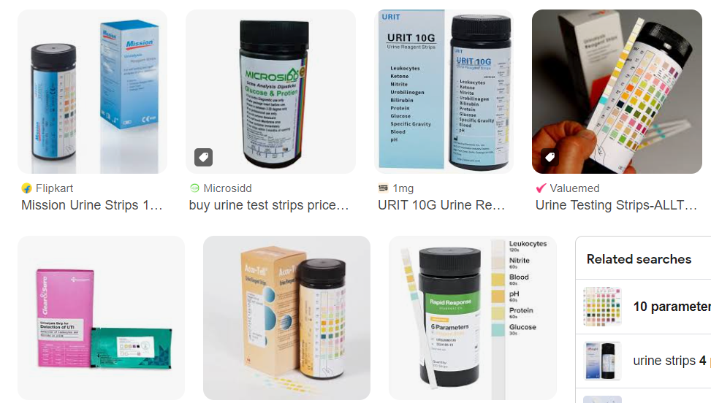
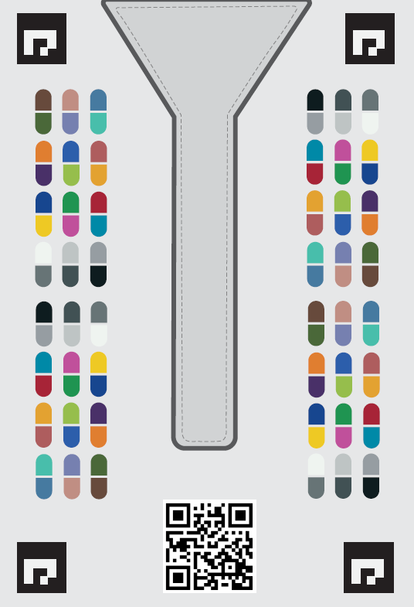


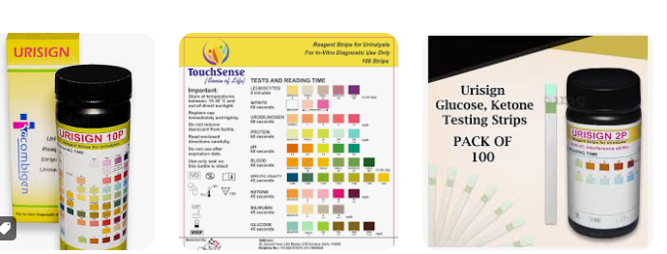

Logistics Snap
BillionTests
BT Card
Mobile Scan App
Online Assessment
Diagnostic test strips
Cloud
Artificial Intelligence
Online Reports
Ready made and well established diagnostic strips
BillionTests
Technology Layer
User does self assessment
at home and gets reports in
~20 seconds

Slide 11
Solution 2 – Edge Device
BillionTests
The BillionTests Edge Device is a smart, plug-and-play urinalysis scanner built for mass testing at scale.
It delivers instant, AI-powered results across 10+ urine parameters and generates tamper-proof blockchain reports for trusted diagnostics.
How It Works
Insert strip → Place the urine test strip into the device.
Automatic scan → Built-in optics capture and calibrate under controlled lighting.
AI analysis → Device interprets 10+ parameters in under 20 seconds.
Instant report → Results shown on connected mobile/desktop app.
Blockchain record → Secured for verification, sharing, and compliance.
Key Advantages
Unlimited testing → One-time cost, no recurring scan charges.
Offline-first → Works without internet; syncs later when connected.
Multi-strip compatible → Not restricted to proprietary strips like Siemens/Roche.
Portable & durable → Lightweight, reliable for field and community use.
11

Slide 12
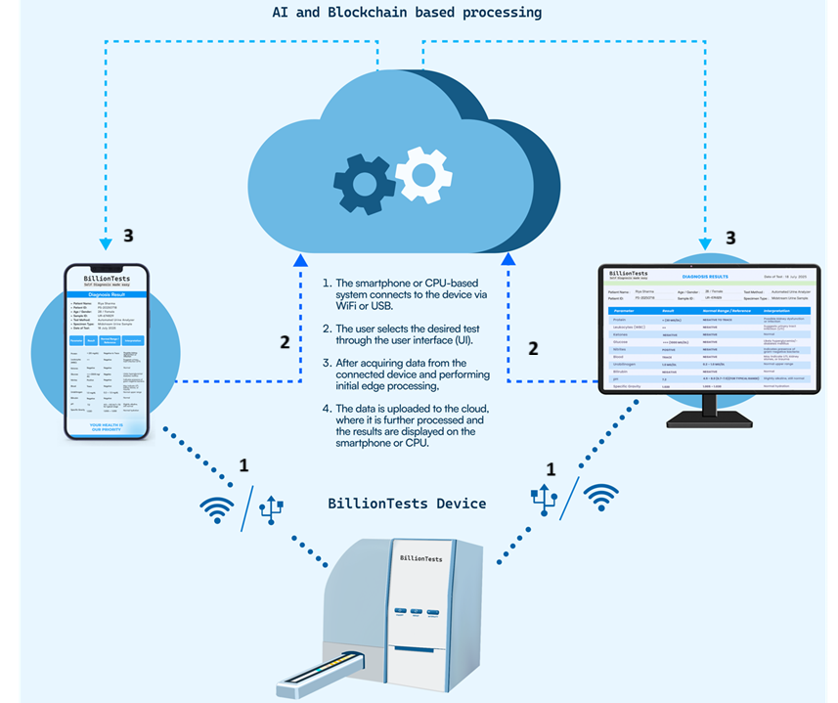
How it Works?
BillionTests
User inserts the test strip into the BillionTests device.
The device is connected to a smartphone or CPU machine via Wi-Fi/ Bluetooth/ USB.
User selects the test to be performed.
The device acquires the data from the strip.
Basic edge processing is done on the device.
The processed data is transferred to the cloud for further analysis.
The final processed results are displayed on the connected smartphone or CPU machine.
1
2
3
4
5
6
7

Slide 13
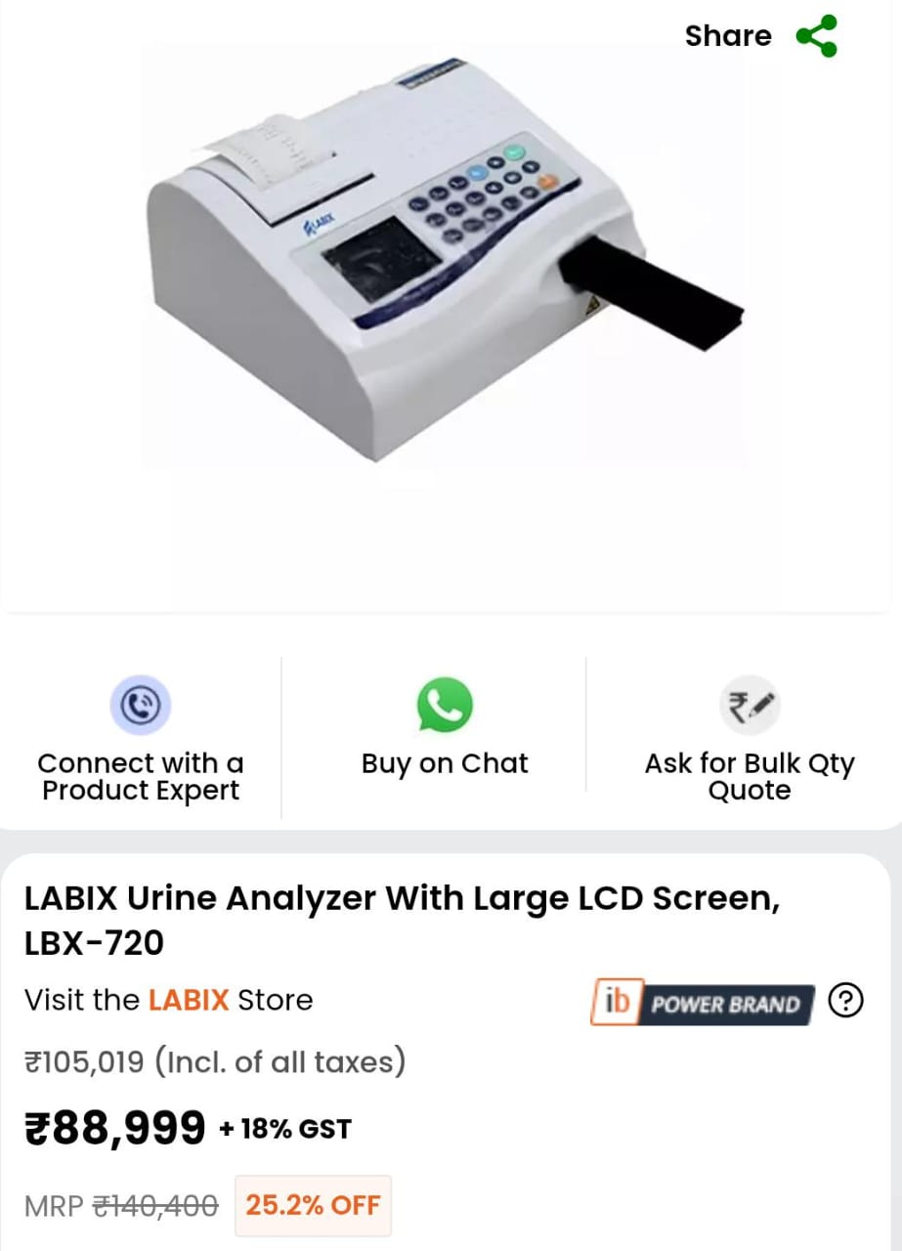
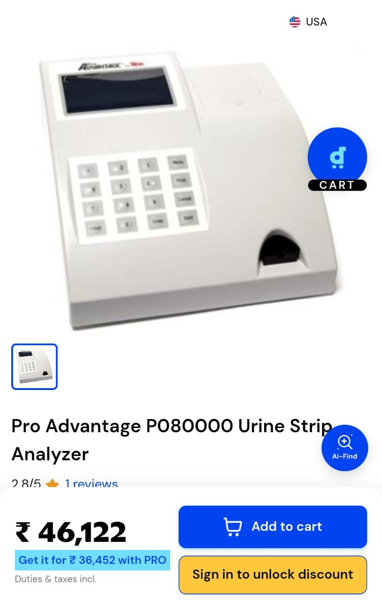
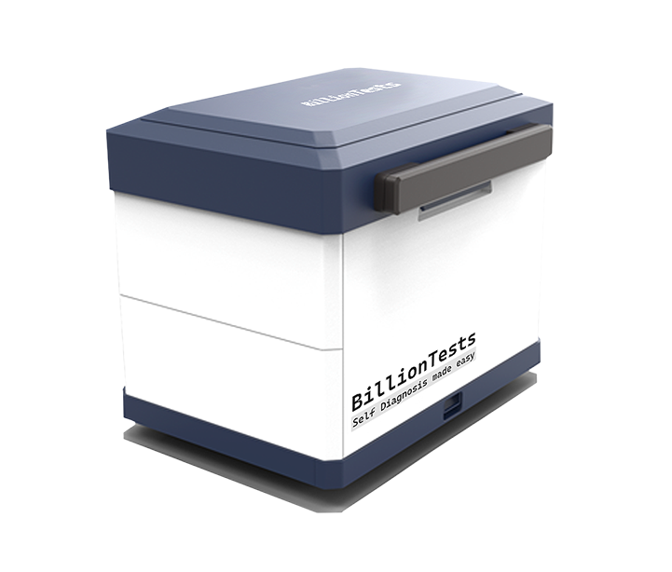
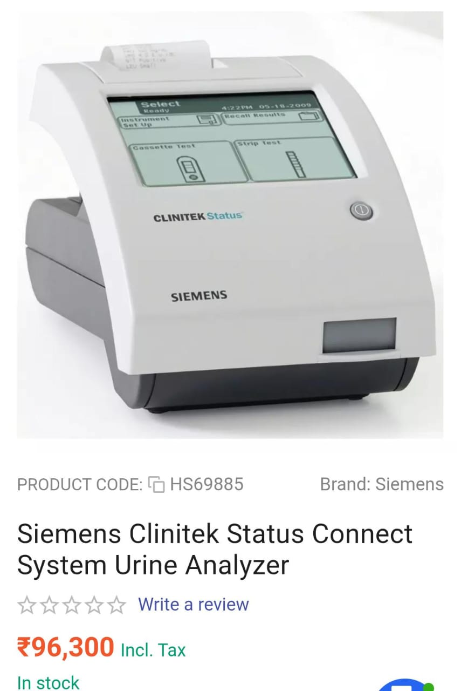
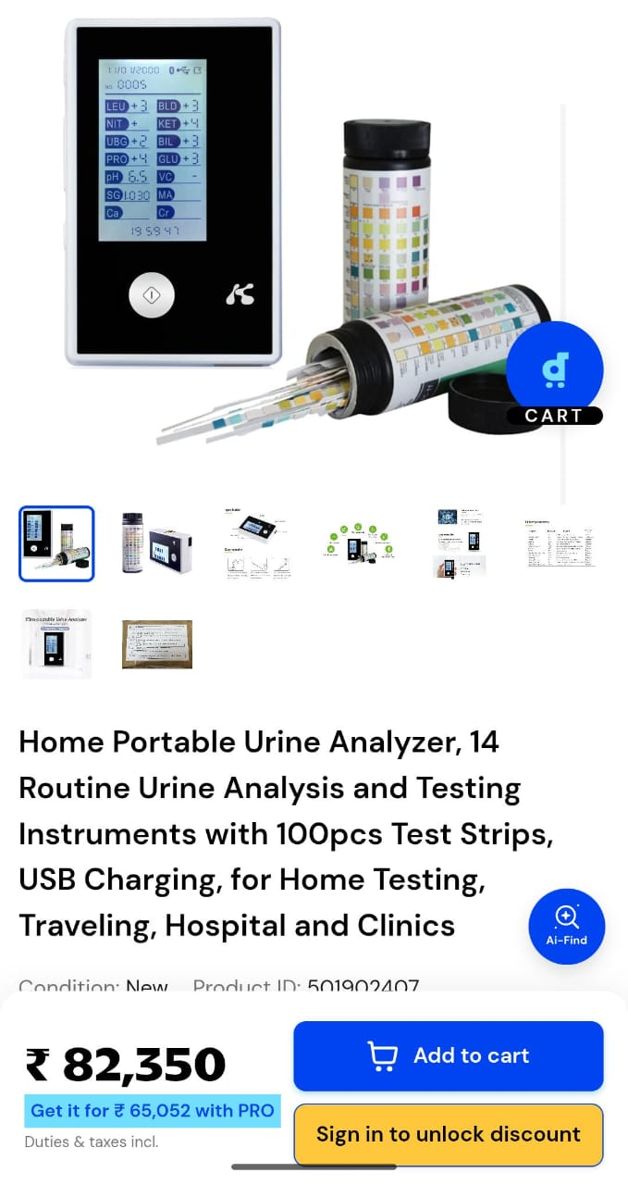
Competition Scenario
BillionTests
  BillionTests
₹1999/-

Slide 14
COMPETITIVE ADVANTAGES
BillionTests
1 vs. Imported Analyzers
90% lower cost
Universal strip compatibility
Portable & field-deployable
No electricity requirement
Indigenous manufacturing
2 vs. Manual Reading
Eliminates human error
Standardized results
Digital records & traceability
No expertise required
Faster turnaround
3 vs. Lab-Based Testing
Point-of-care results
10x lower cost
No sample transport
Immediate clinical decision support
Higher compliance & follow-up
Patent Filed: Core AI-based strip interpretation and calibration methodology under patent protection.

Slide 15
SOCIAL & PUBLIC HEALTH IMPACT
BillionTests
Key Benefits
Early Disease Detection:
Identifies at-risk individuals before symptoms develop
Enables timely intervention and treatment
Reduces progression to severe complications
Reduced Healthcare System Load:
Decreases tertiary hospital admissions
Enables preventive care at primary level
Optimizes resource allocation
Community Health Data:
Real-time population health monitoring
Data-driven policy decisions
Epidemic/outbreak early warning
Health Equity:
Brings diagnostics to underserved populations
Bridges urban-rural healthcare gap
Empowers community health workers
2. Alignment with National Goals
SDG 3: Good Health and Well-being
Ayushman Bharat: Preventive healthcare mission
National Health Mission: Universal health coverage
Digital India: Healthcare digitization
Skill India: Empowers workers with technology
3. Global Impact Potential
According to Lancet Commission:
47% of global population lacks access to early diagnostics
BillionTests addresses this through:
  Ultra-low cost (<$2 per test)
  No infrastructure requirement
  Simple operation (single click)
  Scalable deployment model

Slide 16
Summary of technology validations
BillionTests
Phase | Focus Area | Activities Performed | Outcome
Phase 1 – Core Tech Validation | Mobile Apps | Functional, UI/UX, stress testing across Android & iOS | Done
 | Hardware | Optical calibration, durability, lighting variation tests | Done
 | Connectivity & Location | Local, internet connectivity, GPS validation, secure data transfer | Done
Phase 2 – System Reliability | Blockchain | API integration, transaction stress test, audit validation | Done
 | Cloud Infrastructure | Load testing, auto-scaling, encryption & compliance checks | Done
 | AI Technology | Model training on thousands of strip images, benchmarking vs. experts | Done
Phase 3 – Controlled Testing | Synthetic Urine | Controlled testing with chemical variations of pH, glucose, salt, etc. | Done
 | Reference Validation | Expert card-based reading vs. AI reading comparison | Done
Phase 4 – Field Trials | Local Lab Trials | Multi-city validation in diagnostic labs with real strips | Done
 | User Feedback | Ease of use, speed, adoption study | Done
Phase 5 – Clinical Validation | Institutional Trials | Process started at A. City Imaging (Delhi) and B. GIMS (Greater Noida) | Completed at A
 | Regulatory Prep | Data collection for compliance standards from MedTech Mitra, GIMS (Greater Noida) & COE-AI, IIT Kanpur | In Progress

Slide 17
Future Expansion
BillionTests
BillionTests is not limited to urinalysis — the same AI + IoT + Blockchain platform can power a universal diagnostic ecosystem:
Blood Tests → Hemoglobin, cholesterol, malaria, and rapid test kits.
Glucose Monitoring → Affordable, at-home diabetes management.
Pregnancy & Fertility Tests → hCG, ovulation strips.
Infectious Disease Strips → Malaria, dengue, COVID-19 antigen/antibody kits.
Veterinary Diagnostics → Affordable tests for livestock and pets.
Other Colorimetric Strips → Extensible to 30+ strip types across human and animal health.
Vision: From a urine-based gateway test to a comprehensive, low-cost diagnostic platform serving billions.

Slide 18






Team
BillionTests
The development team comes from IIT Kanpur and IIT Jodhpur, possesses over 10 years of deep expertise in AI and computer vision, with a proven track record of delivering more than 10 state-of-the-art AI products. Key innovations include:
Checko.ai (an IIT Kanpur spin-off) – A highly accurate anti-counterfeiting solution with a 1-in-a-million failure rate. It operates seamlessly on any smartphone and under any lighting conditions, and is trusted by organizations such as Amazon, IOCL, Delhi Excise, and the Security Press.
Upjao.ai – An AI-powered grain quality assessment platform that detects a wide range of grain defects. It is actively used by prominent industry players like ITC FBD, Tata FDRVC, Adani Wilmar, and the Reliance Foundation.
Tracksure – A computer vision-based, end-to-end crate tracking system implemented in large-scale dairy networks including Amul and Hatsun.
Co-founder, Business
Pranav Asthana
M.Tech., IIT K Founded earlier– checko, upjao, schozzle
Co-founder, Product
Ritu Mishra
Ex-Researcher, IIT K Built 5+ deep tech
products from scratch
Co-founder, Tech
Mohini Behera
B.Tech., NIT R
Built 10+ AI Products
Product leader
Karan Rakesh Bahuguna
B.Tech., VIT Vellore
Building BillionTests
Business Manager
Sahil Reddy
B.Tech., VJTI Mumbai
Founded – Ocenip,
Vedicraft
Product Manager
Shreyan Awasthi
Co-founded, externship. Interned at IITH & IIMB.

Slide 19






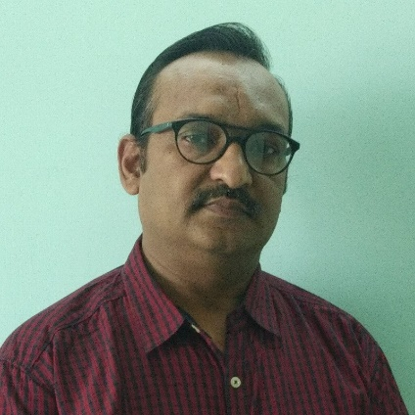

Team: Mentors and employees
BillionTests
Dr. Sudhindra Tatti
CEO of Prompt Innovations
Ph.D. (University of Texas, Austin)
Dr. Shikha Dhawan
Founder, Biozazen
Ph.D. (Delhi University)
Prof. Amitabha Bandyopadhyay
BSBE, IIT Kanpur
Ex-Harvard Medical School
Prof. Sandeep Kumar
EE, IIT Delhi
Ph.D. (IIT Kanpur)
Dr. RAVI VEDURURU
PhD Exec. MBA , Clinical Dx & Medical device Consultant
Dr. Sudheer Kumar
COO (NCFlexe, IIT Kanpur)
Ph.D. (NPL)
Neeraj Garg
Partner, SBM Advisors
Ex-CTO AMUL, NDDB
Prof. Vinod Kurmi
EE, IISER
Ph.D. (IIT Kanpur)

Slide 20
Credibility & Validation
BillionTests
Academic & Technical Credibility
Patent Filed for AI-based strip interpretation and calibration methodology
COE-AI, IIT Kanpur – Technical validation of AI models and system architecture
Core technology developed by IIT Kanpur alumni.
Clinical & Field Validation
Validated at NABL-accredited lab (City Imaging)
98% accuracy benchmarked against lab reference analyzers
Multiple strip brands and real-world lighting conditions tested
Incubation & Regulatory Support
GIMS Greater Noida Incubation Center
  Clinical trials execution
  Compliance and CDSCO navigation
MedTech Mitra: Regulatory guidance & standards compliance
Strategic Deployment Partnerships - Prompt Dairy Tech
  Access to 70,000+ villages for cattle health check
  Devices placed at various centers; strips distributed via health workers
  Home-based scanning enabled through smartphones already present in households
20

Slide 21
Thanks
Pranav Asthana
+91 9651891556
pranav@excl.ai

